Slide 1

kubernetes
Controllers

Slide 2
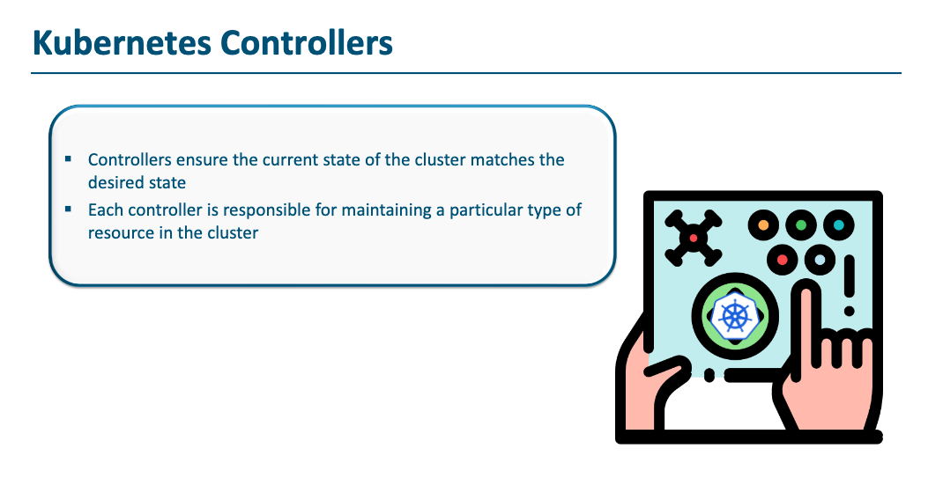

Slide 3
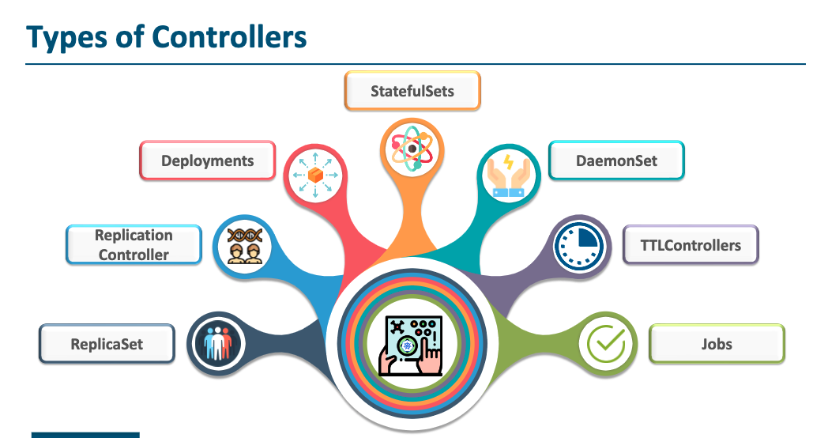

Slide 4
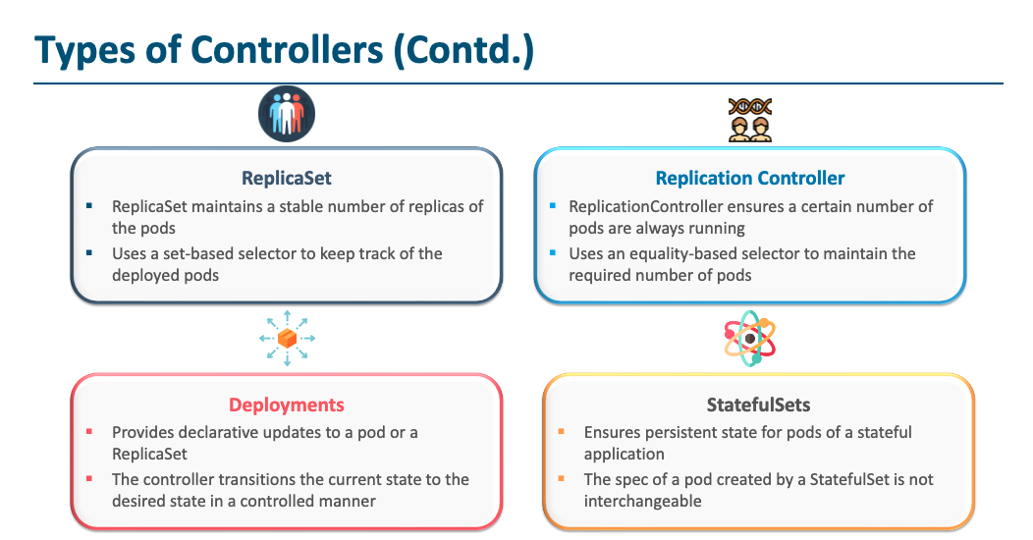

Slide 5
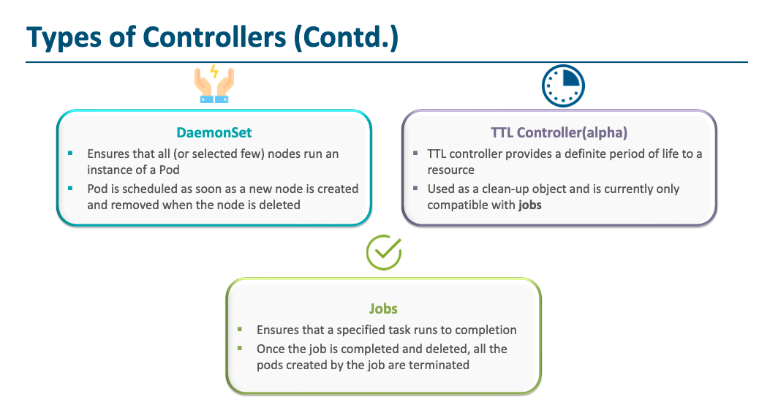

Slide 6
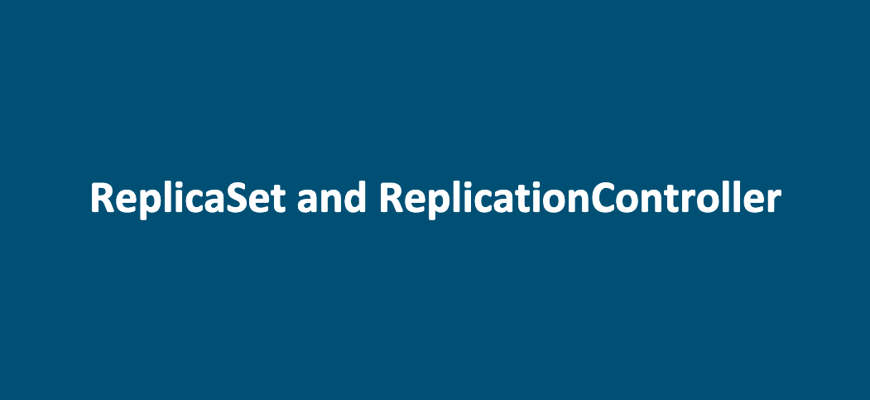

Slide 7
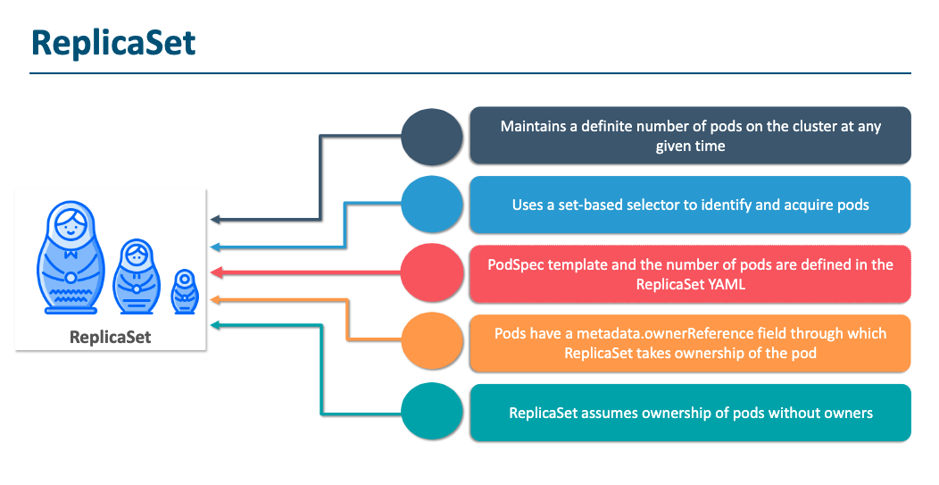

Slide 8
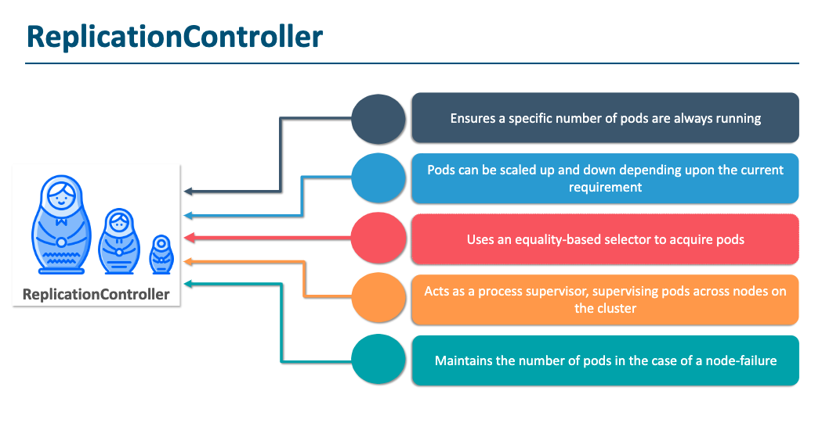

Slide 9
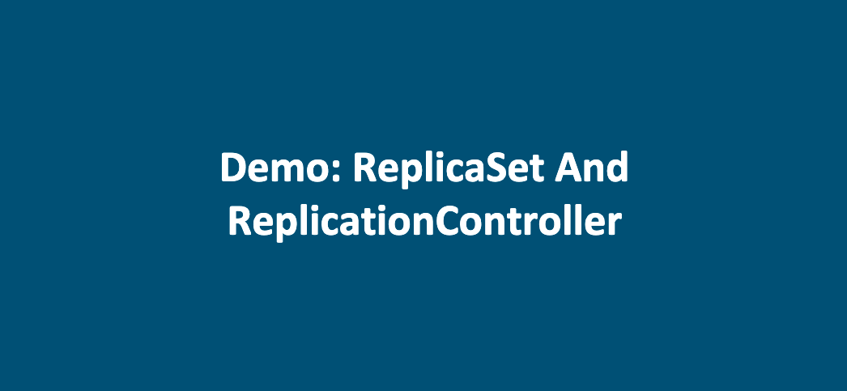

Slide 10
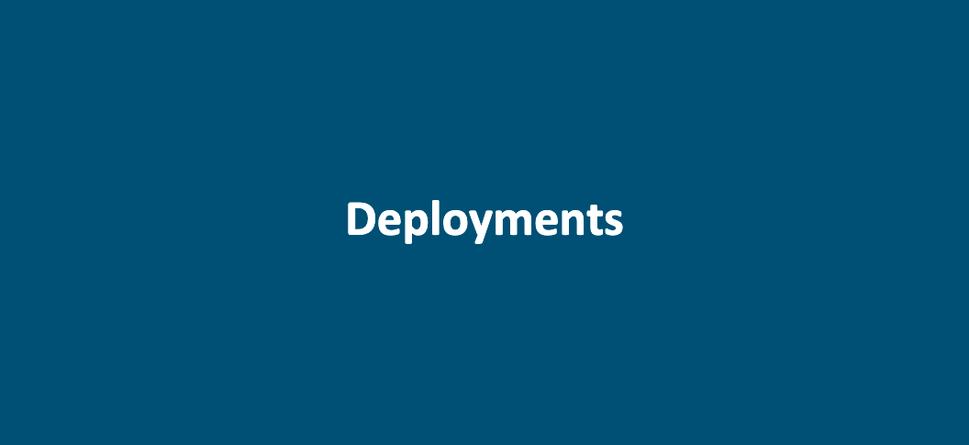

Slide 11
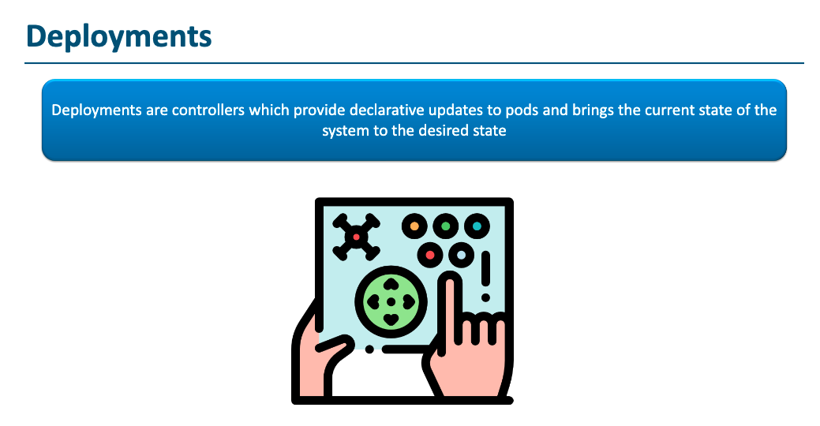

Slide 12
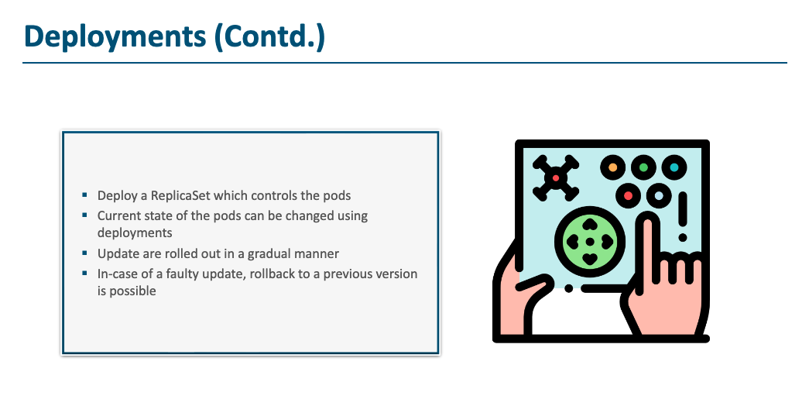

Slide 13


ReplicaSet
Replicas: 2
Pod
container: v1
Pod
container: v1

Slide 14
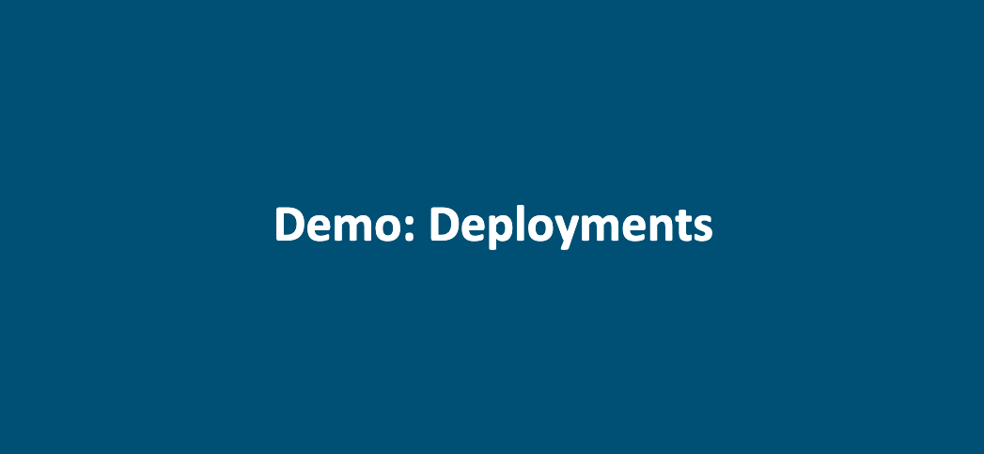

Slide 15
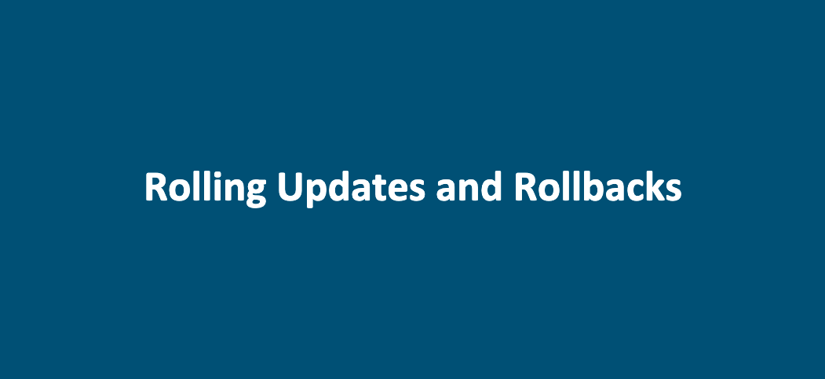

Slide 16
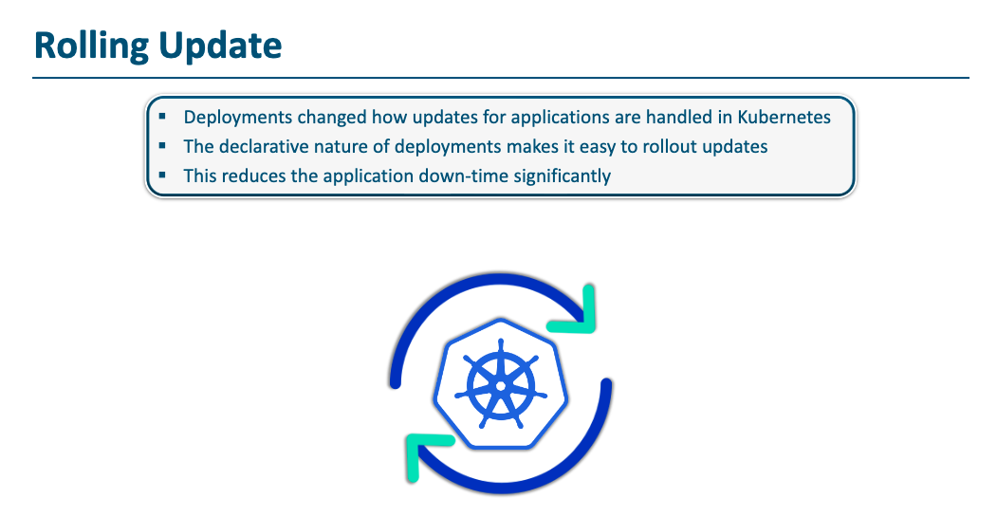

Slide 17
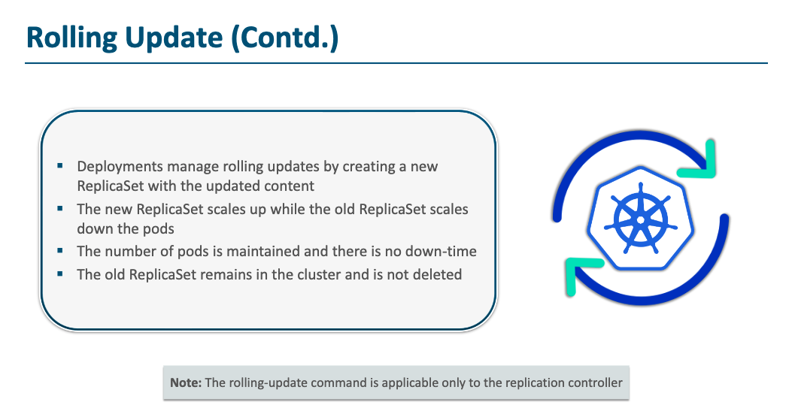

Slide 18
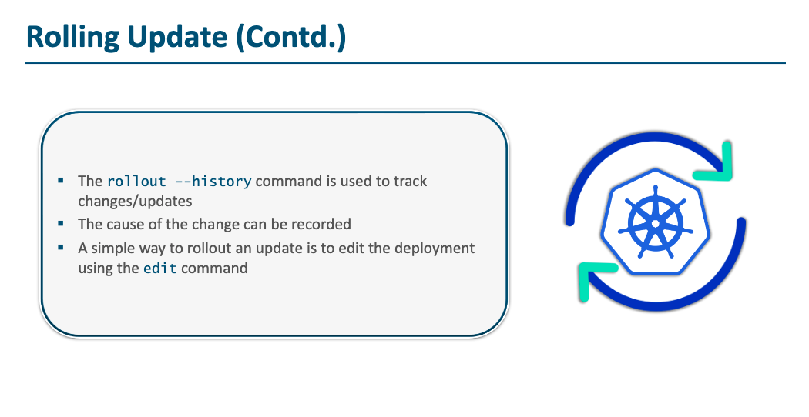

Slide 19
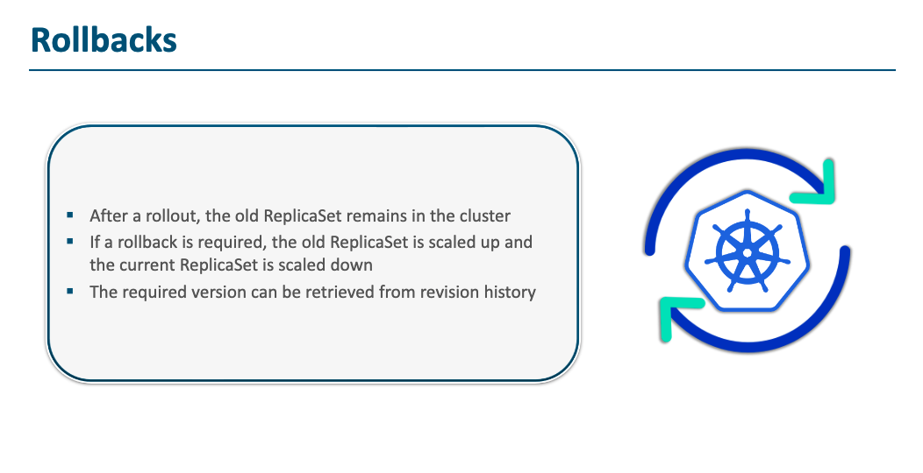

Slide 20
Deployment
ReplicaSet
Replicas: 2
Pod
container: v1
Pod
container: v1

Slide 21
ReplicaSet
ReplicaSet
Replicas: 2
Replicas: 2
Pod
Pod
container: v1
container: v1
Pod
Pod
container: v1
container: v1

Slide 22
ReplicaSet
ReplicaSet
Replicas: 0
Replicas: 2
Pod
container: v1
Pod
container: v1

Slide 23
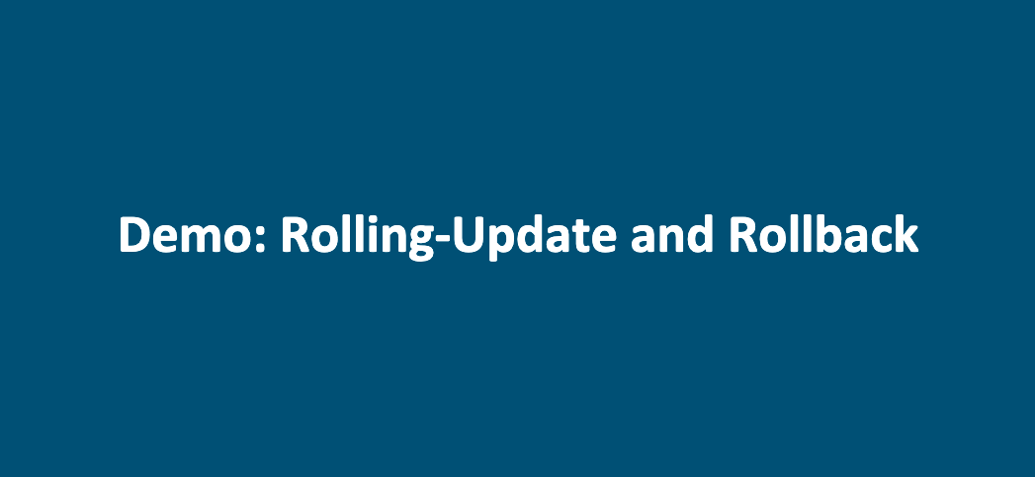

Slide 24
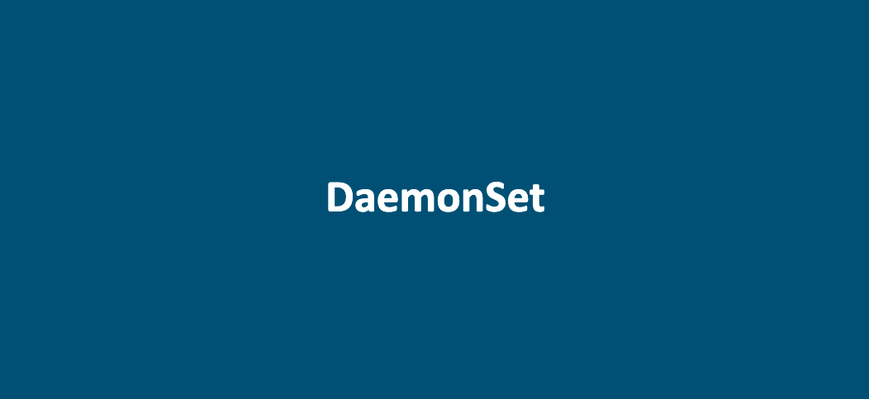

Slide 25
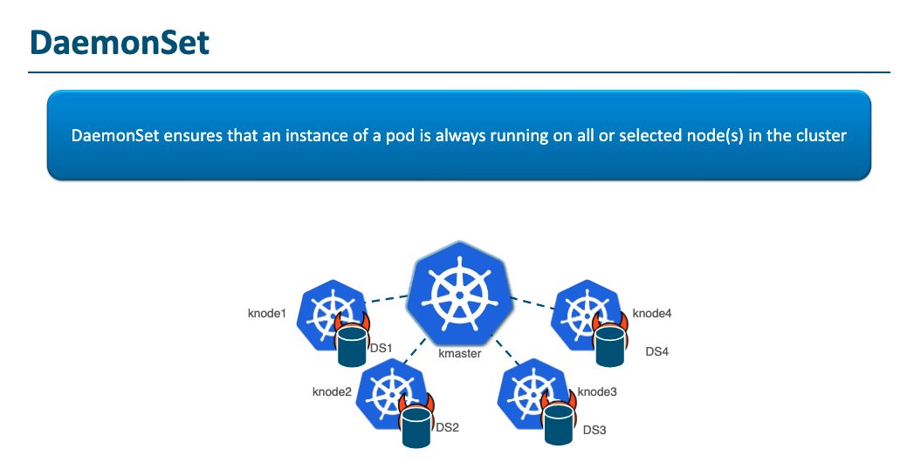

Slide 26
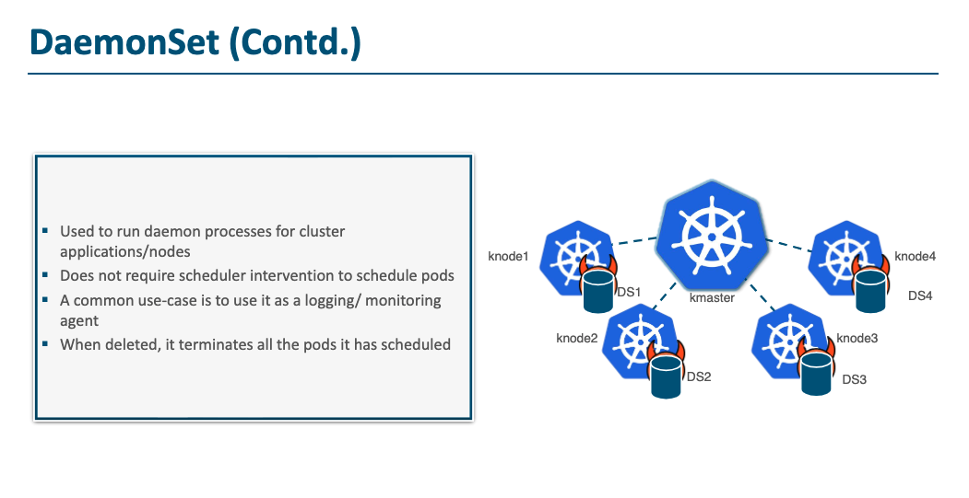

Slide 27
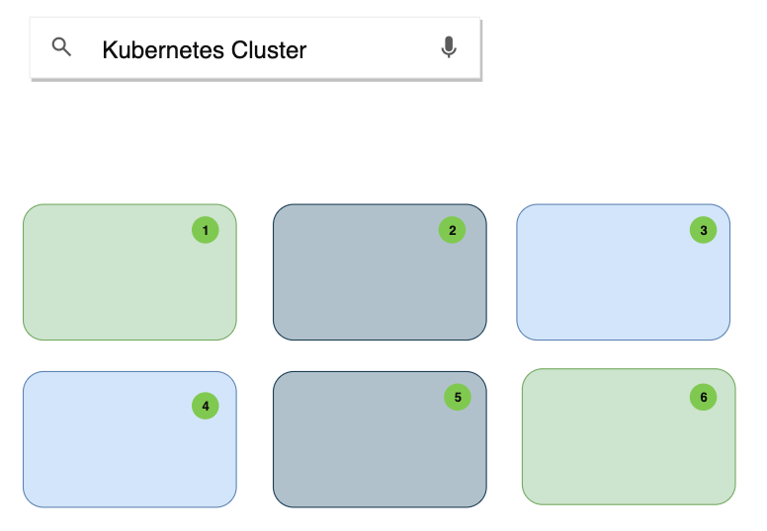

Slide 28
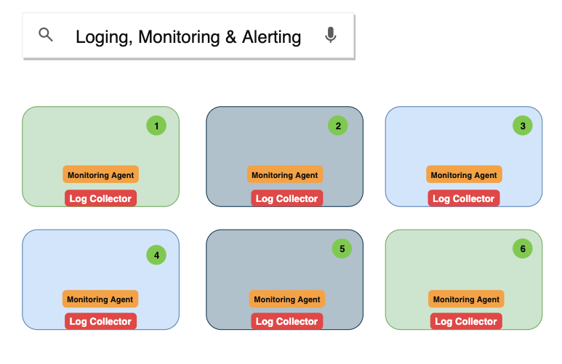

Slide 29
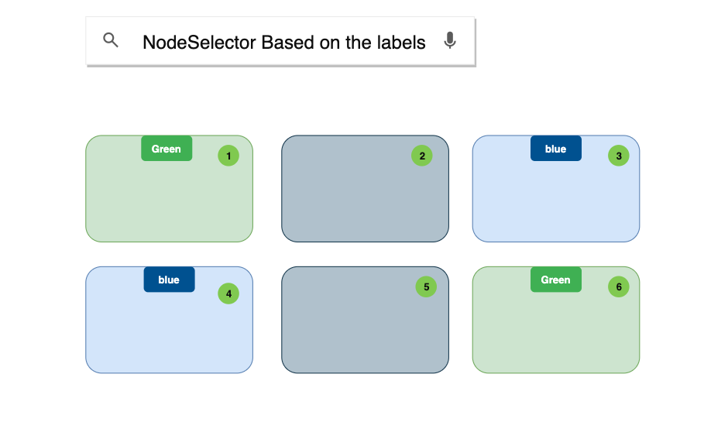

Slide 30
